Slide 1
User Assignment Rules
13 February 2014
Notes:
Guidewire training materials contain Guidewire proprietary information that is subject to confidentiality and non-disclosure agreements. You agree to use the information in this manual solely for the purpose of training to implement Guidewire software solutions. You also agree not to disclose the information in this manual to third parties or copy this manual without prior written consent from Guidewire. Guidewire training may be given only by Guidewire employees or certified Guidewire partners under the appropriate agreement with Guidewire.

Slide 2
Lesson objectives
By the end of this lesson, you should be able to:
Assign objects to users using common assignment methods
Assign claims and activities so that final owner assignment can be done by a user
This lesson uses the notes section for additional explanation and information. To view the notes in PowerPoint, choose View→Normal or View→Notes Page. If you choose to print the notes for the lesson, be sure to select “Print hidden slides.”

Slide 3
Lesson outline
Assignment to users
Manual assignment

Slide 4


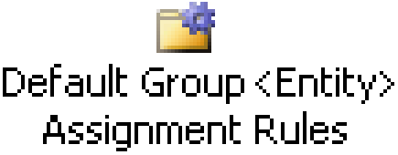
Review: Typical flow of execution
nothing specified
assign to group
Also assigned to user?
yes
no
group specified
assign to user
group and user specified
Done!
Notes:
The diagram above shows a typical flow of execution through assignment rules. The diagram omits processing which is needed for error checking or atypical situations. The omitted processing is discussed later in this lesson and in the "Introduction to Assignment Rules: Group Assignment" lesson.
There are three assignment circumstances:
Neither a user nor group is specified: In this case, global assignment rules are executed. Typically, global assignment rules assign the object only to a group. Afterwards, default group assignment rules are executed, which assign the object to a user within that group. (In some cases, global assignment rules can assign the object to a group and a user in the group. In that case, default group assignment rules are skipped.)
A group has been specified, but not a user: In this case, only default group assignment rules are executed. These rules assign the object to a user in that group.
A group and user has been specified: In this case, no rules are run. The object is simply assigned to the specified user and group.

Slide 5
Common assignment methods
Method | Object | Assigns To...
assignGroup() | Any | The named group
assignGroupByLocation() | Any | Group matching specified location and/or group type
assignGroupBy RoundRobin() | Any | The next child group within the parent group
assign() | Any | The named user (and group)
assignUserBy RoundRobin() | Any | The next user in the group (in a cyclical fashion)
assignUserByLocation() | Any | User matching location
assignToIssueOwner() | Exposure, Activity, Matter | The owner of the claim or related exposure
assignManually() | Any | The group supervisor (who will assign object manually)
assignActivityToQueue() | Activity | The named activity queue
assignByUserAttributes() | Any | A user which matches specified attributes
dynamic assignment | Any | Anything, depending on logic
Notes:
The first two methods, which assign objects to groups, are discussed in the “Introduction to Assignment Rules: Group Assignment" lesson.
The middle six methods, which assign objects to users (or to temporary holding places until a user takes ownership), are discussed in this lesson.
The final two methods are discussed in the “Assignment Rules: Advanced Assignment” lesson of the ClaimCenter 7.0 Application Configuration course.

Slide 6
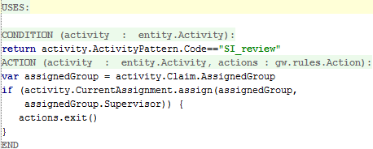
Assigning to a specific user
Syntax: object.CurrentAssignment.assign( group, user)
For example, assign SIU review activities to supervisor of assigned group
Notes:
The ruleset shown is included in the base application.
Note that the assign() method technically assigns both the group and the user (as both parameters are required). However, this method can logically be thought of as a user assignment method. In most cases, when you are selecting a particular user, the group that the user is in is determined by default. (For example, if you assign an activity to the supervisor of the group the activity's claim belongs to, then you have inherently identified the group as well.)
This method could be called from either Global or Default Group rules. If it is called from Global rules, then the object will have an assigned user at the end of execution of that rule set, and therefore the Default Group rules will not execute.

Slide 7
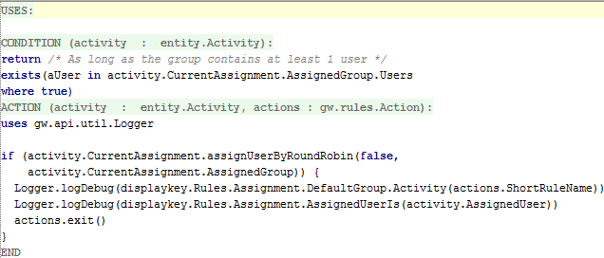
Assigning user by round robin
Syntax: object.CurrentAssignment.assignUserByRoundRobin( includeSubGroups, group)
Notes:
The ruleset shown is included in the base application. It is important to understand that round-robin assignment is distinct from workload-based assignment. Specifically, the round-robin algorithm rotates through a set of users, assigning work to each in sequence. Load factors can be used (in some circumstances) to affect the frequency of assignment to one user or another, but the current number of entities assigned to any of the users is not taken into account with round robin. You may use ClaimCenter’s Weighted Workload if you wish to assign entities based on a user’s workload “weight”, which is not the count of the number of entities, but the sum of the complexity of all items assigned. For more information, consult the “Weighted Workload” lesson in the ClaimCenter 7.0 – 8.0 New Configuration Features course.
The assignUserByRoundRobin() method uses the round-robin user selector to choose the next user from the current group or group tree to receive the assignable. If the includeSubGroups parameter is true, the selector will round-robin not only through the current group, but also through all its subgroups. This is useful in situations in which a set of Claims, for example, are assigned to a particular group, and you want all of the users within that group to share the work­load.

Slide 8
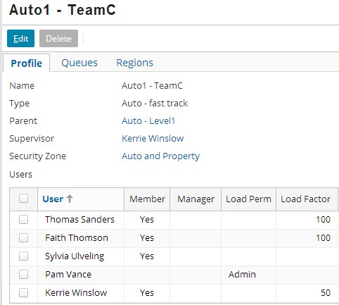
Review: Attributes which influence round robin
Load factors weight distribution of work
Non-members are ignored by round robin
Notes:
If there are no valid users within the selected group (and its subgroups, if the first parameter is true), then assignByRoundRobin returns false. This could occur because:
There are no users in the group.
There are no users in the group who have sufficient permission to own the item. (For example, a sensitive claim routed to a group of adjusters, none of whom have permission to own sensitive claims.)
An individual who is a user of a group but not a member of the group gets certain group-based privileges without getting work assigned to him or her. For example, if a claim is owned by Thomas Sanders in Auto1 - TeamC and access to the claim is limited to people in the group which owns the claim, Pam Vance is able to access the claim.
From a work assignment standpoint, being a non-member is equivalent to being a member with a load factor of 0.
(The Load Perm column is for assigning permissions related to load factors. A user with "View" can view load factors. A user with "admin" can modify load factors.)

Slide 9
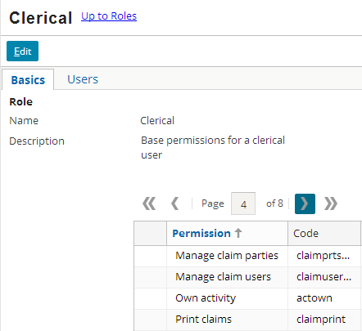
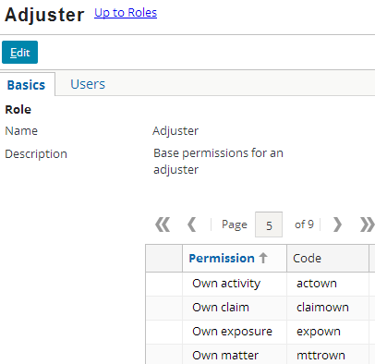
Review: Permissions determine assignment
Users who lack permission to own assignable objects are ignored by round robin
Notes:
A user who does not have "own <object>" permissions will be ignored by assignByRoundRobin when assigning objects of that type.

Slide 10
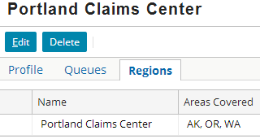
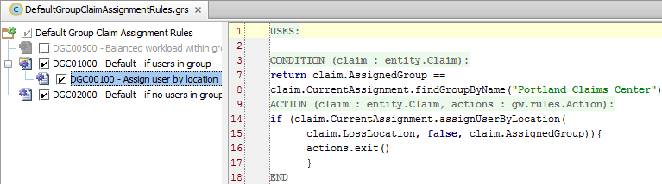
Assigning user by location
Syntax: object.CurrentAssignment.assignUserByLocation( address, includeSubGroups, group)
Assigns to user:
In region covering specified address...
...including all descendent groups or just immediate group...
...beginning with the users of specified group
Notes:
The rule set example shown is not in the base application.
Similar to assignGroupByLocation (which is discussed in the “Introduction to Assignment Rules: Group Assignment” lesson), users are matched first by zip, then by county, then by state (for the United States). The example above includes a large geographic area –the entire Pacific Northwest of the United States (Oregon, Washington and Alaska). The first match wins. If one or more users match at a particular location level then assignment will round robin through that set and will ignore any matches at a lower level. For example, if there are no users that match by zip but a few that match by county then assignment will round robin through the ones that match by county and will ignore any others that match by state.
The AssignableEnhancement’s findGroupByName() method is used to identify a specific group by name. The AssignableEnhancement is discussed in the “Introduction to Assignment Rules: Group Assignment” lesson.

Slide 11
If multiple users cover single location
Zip Code
90005
Peter Beebe
Leroy Martel
Dana Evans
If multiple users match single region criteria, then assignment "round-robins" through those users
Users do not have to be in same group
For round-robining outside of assignUserByRoundRobin, load factors are ignored
Notes:
Whenever ClaimCenter attempts to assign an object to a user using a criteria other than simple group membership and it finds more than one user, it will round robin items within that set of users. Because this is round robining within a "set" of users rather than a formal group, load factors are ignored. (Load factors are specified only for a user who belongs to a given group, because load factors are only meaningful as a comparative value between members of a predefined group.)
The round-robin sequence is tied to the set of criteria, not the set of users. So using the same set of restrictions to find a set of users will re-use the same round-robin sequence, but two different sets of restrictions will result in distinct round-robin sequences, even if the set of resulting users is the same. For example, if three are three users (Alan, Barbara, and Clark) in zip code 1 and three users (Clark, Dan, and Emily) in zip code 2, then assignments to zip code 1 will round robin only through Alan, Barbara, and Clark. Assignments to zip code 2 will round robin through Clark, Dan, and Emily. Because Clark is in two zip codes, it is likely he will get more work - at least through location-based assignment - than the other users. However, whenever he is assigned an object through zip code 1, it doesn't alter how assignments in zip code 2 are done.

Slide 12
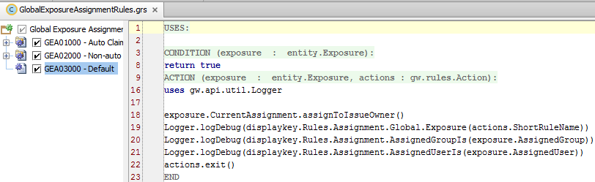




Assigning to “issue owner"
Syntax: object.CurrentAssignment.assignToIssueOwner()
For subobjects only
Exposure - assigned to claim owner
Service Request – assigned to claim owner
Claim/Service Request activity - assigned to claim owner
Exposure/matter activity - assigned to exposure/matter owner
Notes:
The rule set example shown is included in the base application. The assignToIssueOwner() method is designed to move up the hierarchy of objects until it finds an object that has an owner. For exposures, this would be the claim. For activities, it can be more complex because an activity may or may not be linked to an exposure. If it is linked to an exposure (in other words, if the activity's Exposure field is non-NULL), then Activity.assignToIssueOwner() will assign the activity to the exposure owner. If not, then it will assign it to the claim owner.

Slide 13
Additional user assignment methods
assignUserByLocationUsingProximitySearch
Assigns to user with closest proximity to given location (address)
assignUserAndDefaultGroup
Assigns to specified user and first group user belongs to
assignByUserAttributes / assignUserByLocationAndAttributes / assignUserByLocationUsingProximitySearch assignUserByLocationUsingProximityAndAttributes
Assigns to user with given set of user attributes, and/or within proximity of given location
Notes:
Unlike the assignUserByLocation, which round-robins assignment among users with the same location, assignUserByLocationUsingProximitySearch does not use round-robining. It always assigns the object to the single closest user.
For some customers, users belong to only a single group, or the assigned group has no security implications. In these cases, the assignUserAndDefaultGroup is a useful shortcut to finding a specific group for the object to belong to.
The last four methods (third bullet point) are discussed in the ClaimCenter 8.0.0 Rules Guide and in the “Assignment Rules: Advanced Assignment” lesson of the ClaimCenter 7.0 Application Configuration course.

Slide 14
Lesson outline
Assignment to users
Manual assignment

Slide 15
Two situations where final user not assigned by rules
Objects may be marked as pending assignment
Objects assigned to group but no user yet
Supervisor manually assigns objects to users in group
Activity queue holds activities assigned to group but not user
Users in group can take ownership of activities from queue)
Peter Beebe
Peter Beebe
Notes:
There are two situations where the owner of an assignable object is chosen by a user (as opposed to assignment rules)
Assignable objects are sometimes marked as pending assignment. The supervisor sees a list of activities, one for each object that is pending assignment. The supervisor then manually assigns each object to a specific user within the group.
Activities are sometimes assigned to a group queue. Users within the group can take ownership of the activities in the queue.

Slide 16
Common assignment methods
Method | Object | Assigns To...
assignGroup() | Any | The named group
assignGroupByLocation() | Any | Group matching specified location and/or group type
assignGroupBy RoundRobin() | Any | The next child group within the parent group
assign() | Any | The named user (and group)
assignUserBy RoundRobin() | Any | The next user in the group (in a cyclical fashion)
assignUserByLocation() | Any | User matching location
assignToIssueOwner() | Exposure, Activity, Matter | The owner of the claim or related exposure
assignManually() | Any | The group supervisor (who will assign object manually)
assignActivityToQueue() | Activity | The named activity queue
assignByUserAttributes() | Any | A user which matches specified attributes
dynamic assignment | Any | Anything, depending on logic
Notes:
The first two methods, which assign objects to groups, are discussed in the "Assignment Rules - Group Assignment" lesson.
The middle six methods, which assign objects to users (or to temporary holding places until a user takes ownership), are discussed in this lesson.
The final two methods are discussed in the “Assignment Rules: Advanced Assignment” lesson of the ClaimCenter 7.0 Application Configuration course.

Slide 17
"Pending assignment" objects
Terence Johnson
Scott Arthur
Los Angeles Auto Adjusters Pending assignments
Wesley Roosevelt
Assignable objects can be marked "pending assignment“
“Assign object” activities are created and appear only on a special list visible only to the supervisor of the group
The supervisor is responsible for manually assigning the object to a member of the group
Notes:
Pending assignment is typically used when you want the final assignment to be based upon human judgment.

Slide 18

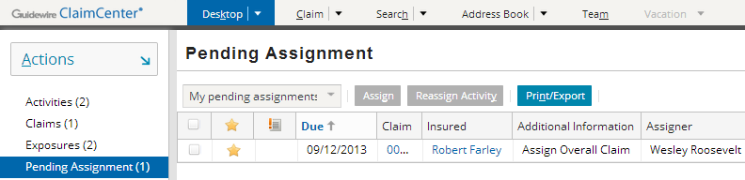
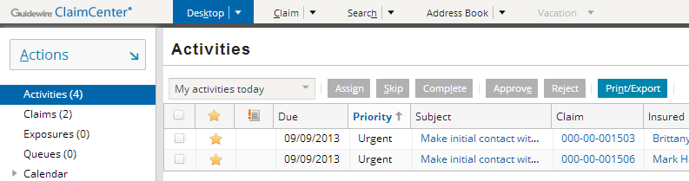
The pending assignment list
Typically, Pending Assignment is visible only to group supervisors
Lists claims requiring manual assignment
Notes:
In the example above (top screenshot), the user is Wesley Roosevelt. From his desktop, he can see there is one claim in the Pending Assignment list. From this list, she can access the claim and/or assign the claim manually as appropriate. The group manager would not see the Pending Assignment list on her desktop.

Slide 19
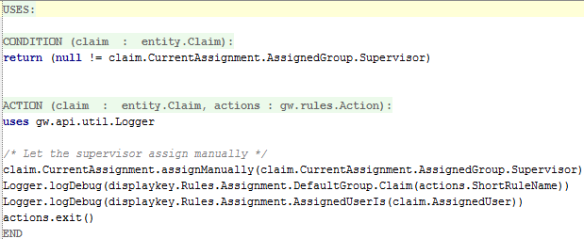
Manually assigning objects
Syntax: object.CurrentAssignment.assignManually(namedUser)
Activities to assign these objects appear in "Pending Assignment" list, which is visible only to named user, typically a supervisor
Notes:
The rule set shown in the above is included in the base application. Developers should ensure that the user chosen by the assignManually method has the permission to view and reassign claims manually. Otherwise, the claims would be assigned to a user who lacked permissions to manually assign them to someone else.

Slide 20
Activity queues
Western Salvage Unit
Vehicle salvage opportunity
Lucas Fleming
Vehicle salvage opportunity
Salvage Actions
A queue is a repository associated to a group for activities assigned to group but not yet assigned to any user
Users can take ownership of activities in queue
Notes:
Unlike groups and users, which can own any type of assignable object, queues can contain only activities.

Slide 21
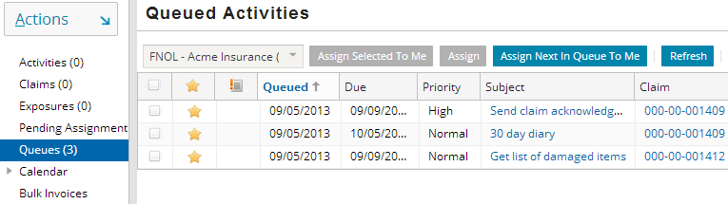
Activities in a queue: Example
From the Desktop, users can
View activity queues accessible to them
Take ownership of the next activity in given queue
Notes:
Users can view objects assigned to queues they have access to by clicking the Queues page link on the Desktop tab. The queues the user has access to are listed in the dropdown at the top of the list. Once the user selects a given queue, all objects in the queue appear in the list. The user can then take ownership of a given queue by clicking the "Assign Next In Queue To Me" button.

Slide 22
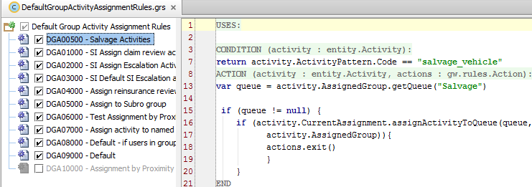
Retrieving queue of given name
Syntax: group.getQueue("name")
Returns queue of specified name from specified group (if given group has queue with that name)
Case-sensitive
Notes:
The example shown is not in the base application.
In order to assign an activity to an activity queue, you must identify the queue to which the activity is to be assigned. Typically, the queue is selected by its name. (Salvage activities go the "Salvage" queue. FNOL activities go to the "FNOL" queue.) However, there is no guarantee that the group to which an activity has been assigned has a queue by that name. (Also, the assignActivityToQueue method requires the queue to be passed as an object. You cannot identify the queue simply by its name.)
Therefore, before you attempt to assign an activity to a queue, you must first retrieve the desired queue. This is typically done by saving the group to which the activity is currently assigned in a variable and then using the getQueue method.
In the Rule Actions example above: Line 13: Create a queue variable, and set its value to the queue named "Salvage" on the current group. (If no such queue exists, the method returns null.)

Slide 23
Assigning to specific activity queue
Syntax: activity.CurrentAssignment.assignActivityToQueue( queue, group)
Notes:
In the Rule Actions example above:
Line 15: If a queue named "Salvage" was found on the current group...
Lines 16-17: Assign the activity to the "Salvage" queue on the current group.

Slide 24
What if user assignment fails?
nothing specified
assign to group
no
"Default Owner" and root group*
Was group assigned?
yes
Was user assigned?
yes
group specified
no
assign to user
yes
Was user assigned?
no
yes
New group assigned?
no
Assign to group supervisor
Done!
Notes:
After default group assignment rules have been executed, the assignment engine checks to see if the object was assigned to a user. There are three possible outcomes.
If the object was assigned to a user (or marked as pending assignment, or assigned to an activity queue), then assignment is done.
If the object was not assigned to a user, but it was assigned to a new group, then the default group rules are re-executed. This behavior can be used to have an object travel from a parent group to a child group before being assigned to a user at the appropriate child group level.
If the object was not assigned to either a user or a new group, then the object is assigned to the current group supervisor. This assignment behavior is inherent to the assignment engine and cannot be modified.
Console logging messages at the WARN level identify when an object cannot be assigned to a user within the Default Group rule set. The logging messages should appear like the following: hoades-w53 2013-12-05 07:34:06,388 WARN Assignment rules did not determine a group
hoades-w53 2013-12-05 07:34:06,388 WARN Assignment rules did not reach decision. Using defaults
hoades-w53 2013-12-05 07:34:06,388 WARN Assignment: rules did not select user; attempting to assign to claim owner
NOTE (*)
If this is a new claim assignment, the claim is assigned to the Default Owner. If this is a claim reassignment, group assignment failure results in the claim retaining its current owner.
In the case of a sub-object, such as an activity, if the Global Assignment Rules activity assignment rules fail to assign to a user, the assignment is made to the associated claim owner.

Slide 25
Review: Complete flow of assignment rules
nothing specified
assign to group
no
"Default Owner" and root group
Was group assigned?
yes
Was user assigned?
yes
group specified
no
assign to user
yes
Was user assigned?
no
yes
New group assigned?
no
group and user specified
Assign to group supervisor
Done!
Notes:
The diagram above represents the complete flow of assignment rules. Except for the "group and user specified" scenario (which bypasses both assignment rule sets), this diagram is identical to the one on the previous slide.

Slide 26
Lesson objectives review
You should now be able to:
Describe how objects are assigned to users
Assign objects to users using common assignment methods
Assign claims and activities so that final owner assignment can be done by a user

Slide 27
Review questions
When a user is assigned to a group, what attributes influence whether the assignUserByRoundRobin method will assign objects to that user?
What happens if the assignUserByLocation method is executed multiple times, each time specifying the same location?
What types of objects are assigned using:
assignToIssueOwner?
assignManually?
assignment to a group queue?
Notes:
Answers
1. Membership in the group, load factor, and permission to own objects.
2. The first assignment will go to the first user in that location; the second will go to the second user, and so on. In other words, the method "round robins" assignment through the users at the location. However, in this kind of round robining, the users do not have to belong to the same group and load factors are ignored.
3. a) Exposures, Activities, and Matters
b) Any assignable object can be assigned this way, but activities show up in the pending assignment list
c) Activities

Slide 28
Notices
Copyright © 2001-2014 Guidewire Software, Inc. All rights reserved.
Guidewire, Guidewire Software, Guidewire ClaimCenter, Guidewire PolicyCenter, Guidewire BillingCenter, Guidewire Reinsurance Management, Guidewire ContactManager, Guidewire Vendor Data Management, Guidewire Client Data Management, Guidewire Rating Management, Guidewire InsuranceSuite, Guidewire ContactCenter, Guidewire Studio, Guidewire Product Designer, Guidewire Live, Guidewire DataHub, Guidewire InfoCenter, Guidewire Standard Reporting, Guidewire ExampleCenter, Guidewire Account Manager Portal, Guidewire Claim Portal, Guidewire Policyholder Portal, ClaimCenter, BillingCenter, PolicyCenter, InsuranceSuite, Gosu, Deliver Insurance Your Way, and the Guidewire logo are trademarks, service marks, or registered trademarks of Guidewire Software, Inc. in the United States and/or other countries.
All other trademarks are the property of their respective owners.
This material is confidential and proprietary to Guidewire and subject to the confidentiality terms in the applicable license agreement and/or separate nondisclosure agreement.
This file and the contents herein are the property of Guidewire Software, Inc. Use of this course material is restricted to students officially registered in this specific Guidewire-instructed course, or for other use expressly authorized by Guidewire. Replication or distribution of this course material in electronic, paper, or other format is prohibited without express permission from Guidewire.
Guidewire products are protected by one or more United States patents.

